Slide 1


Athens University of Economics and Business
MSc in Business Analytics (Part Time 2020)
Machine Learning and Content Analytics
Project
Mantzos Georgios (p2822012)
Dimitriou Ioannis (p2822006)

Slide 2

Contents
Description of the Project
Data
Overview
Extract – Transform – Load (ETLs)
Exploratory Data Analysis (EDA)
Methodology – Experimentation
Classification Models
Clustering Models
Meet our Team

Slide 3
1. Description of the Project
1st Phase
2nd Phase
An end-to-end Natural Language Processing Project
Started with Argument, Structure and Citance Labeling training on documents abstracts.
Proceeded with in-practice documents labeling in Label Studio to produce data.
Our team completed labeling in 96 Abstracts.
After the labeling task of all teams, data was produced for Argument, Structure and Citance labels.
Argument Labeling Prediction Model
Baseline Intuitive Model.
Argument Model with the given labels.
Structure Labeling Prediction Model
Citance Labeling Prediction Model
Abstract Clustering

Slide 4

2.1 Data - Overview
1
For Structure
1
For Citances
1014 Abstracts
10548 Sentences
1014 Abstracts
10548 Sentences
4
Datasets
5 Labels
I. Result
II. Background
III. Method
IV. Conclusion
V. Objective
* Neither
4 Labels
I. Neutral
II. Irrelevant
III. Positive
IV. Negative
* Neither
2
For Arguments
1669 Abstracts
1017 Abstracts
Total 2686 Abstracts
Total 32004 Sentences
3 Labels
Claim
Evidence
Neither

Slide 5

2.2 Data – Extract / transform / load (ETLs)
Assign 3 new variables
1. Sentences_Per_Doc: Showing the number of sentences in each Document.
2. Sentences_Id: The real index of each Sentence.
3. In_Doc_Sentence_Id: The internal Id for any sentence in each Document, taking values from 0 to the "Sentences_Per_Doc" value of each document.
We remove the title form each document, since that will cause some bias (always “NEITHER”)
We put a threshold of 25 sentences / abstract in order to eliminate outliers in our dataset ( ~ 1% loss of information)
Ready for Exploratory Data Analysis (EDA)

Slide 6

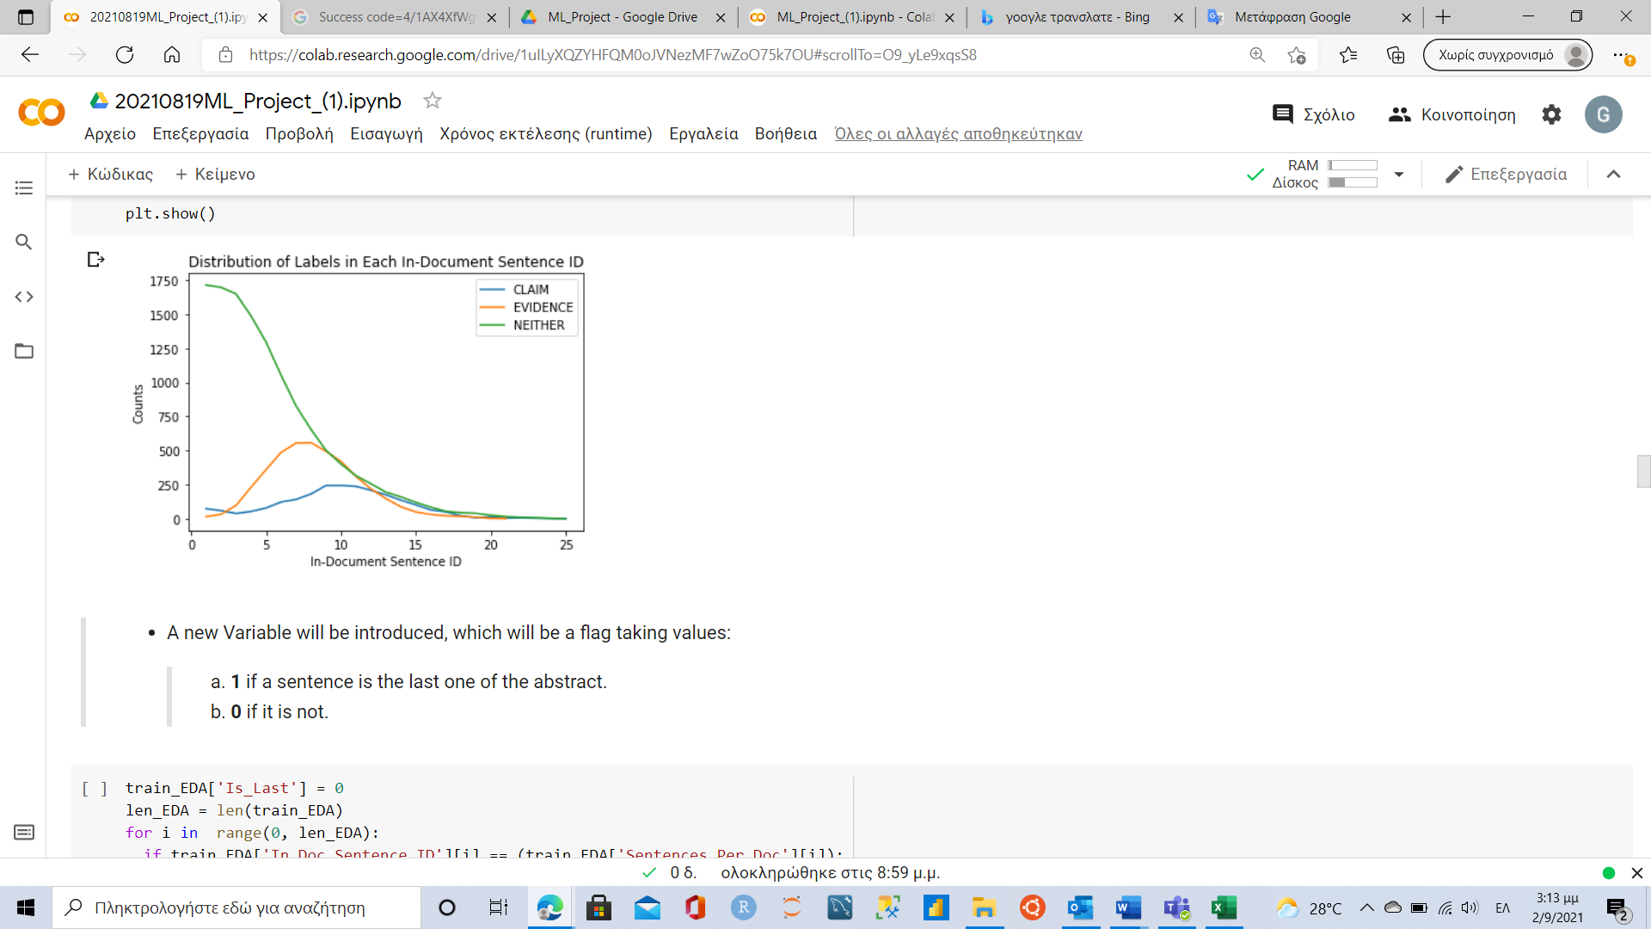
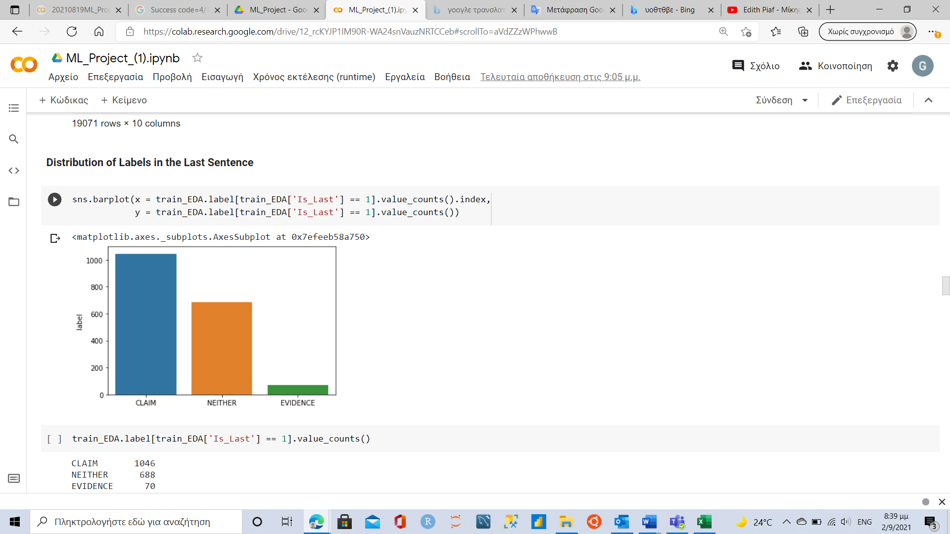
2.3 Data – exploratory data analysis (eda) (1/2)
Assign 6 new variables
3 of them count the number of labels in each abstract. These variables will be “claims”, “evidences” and “neithers”.
The other 3 show if a sentence of the abstract is the last, the pre-last or the second sentence before last with names “Is_Last”,
“Is_Pre_Last” and “Is_2_Before_Last”.
When an abstract comes up to it’s end , then a convergence among the three labels it is occurred (from 12th to 25th sentence)
57.98% of the last sentences in each document are CLAIMS and the 45.74% of the CLAIMS are in the last sentence.
3.88 % of the last sentences in each Document are EVIDENCE and the 1.68 % of the EVIDENCE are in the last sentence.

Slide 7

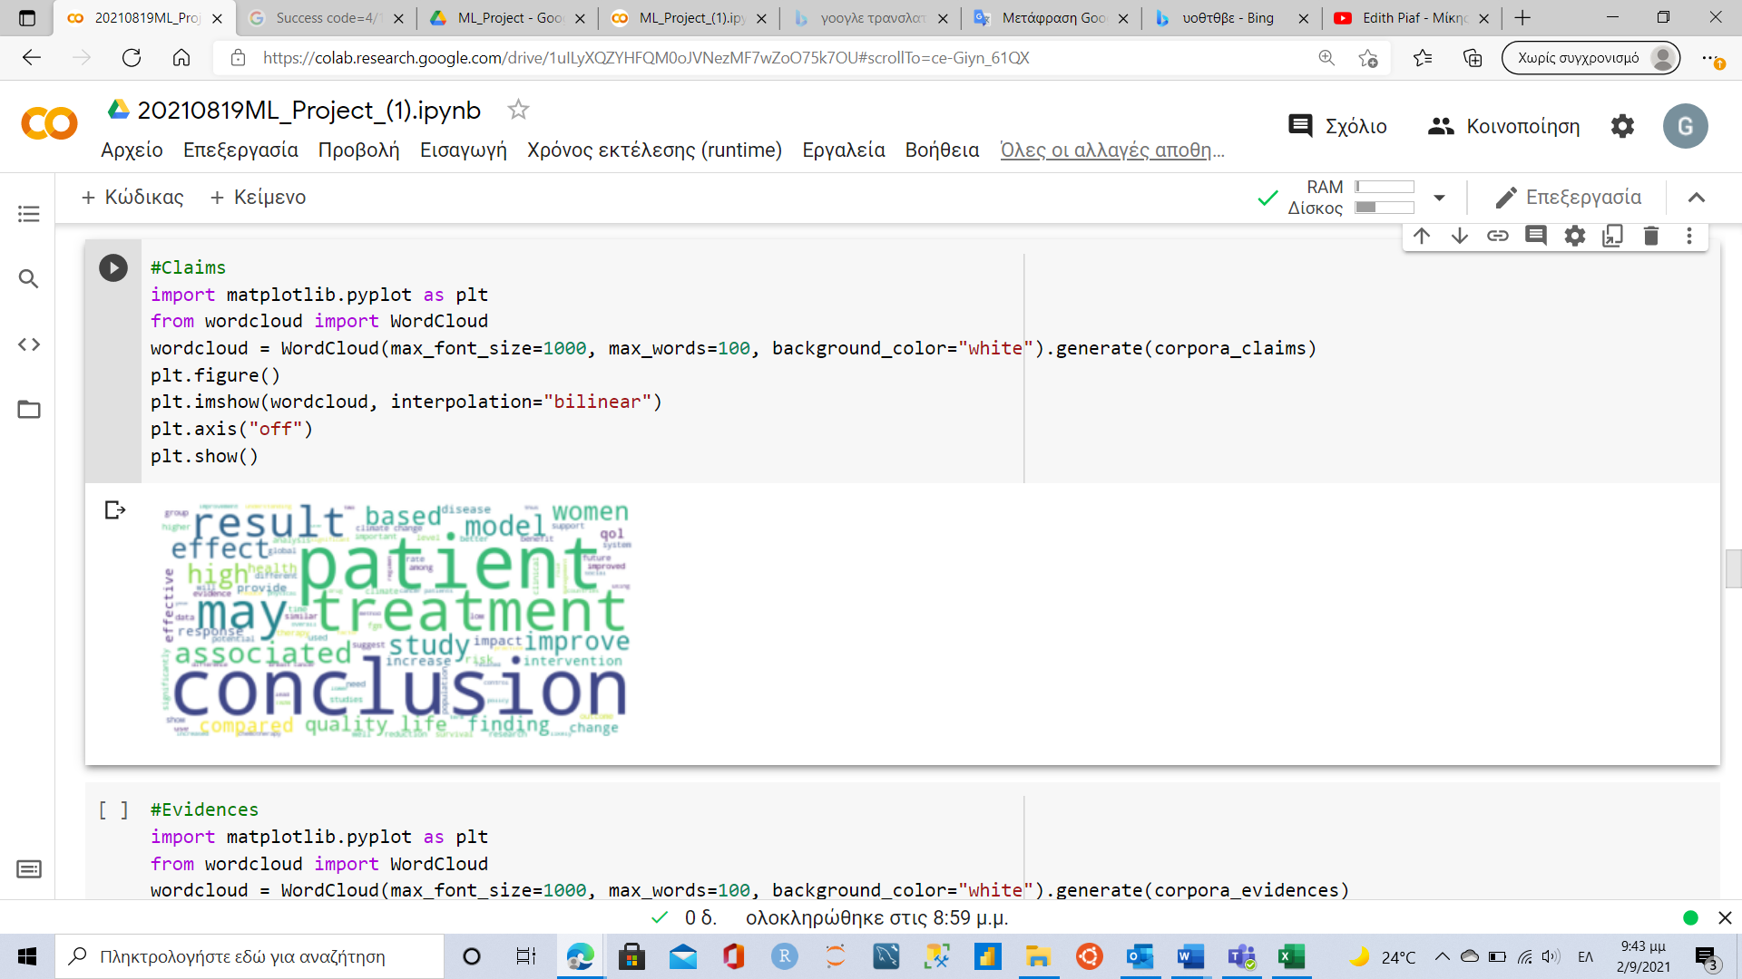
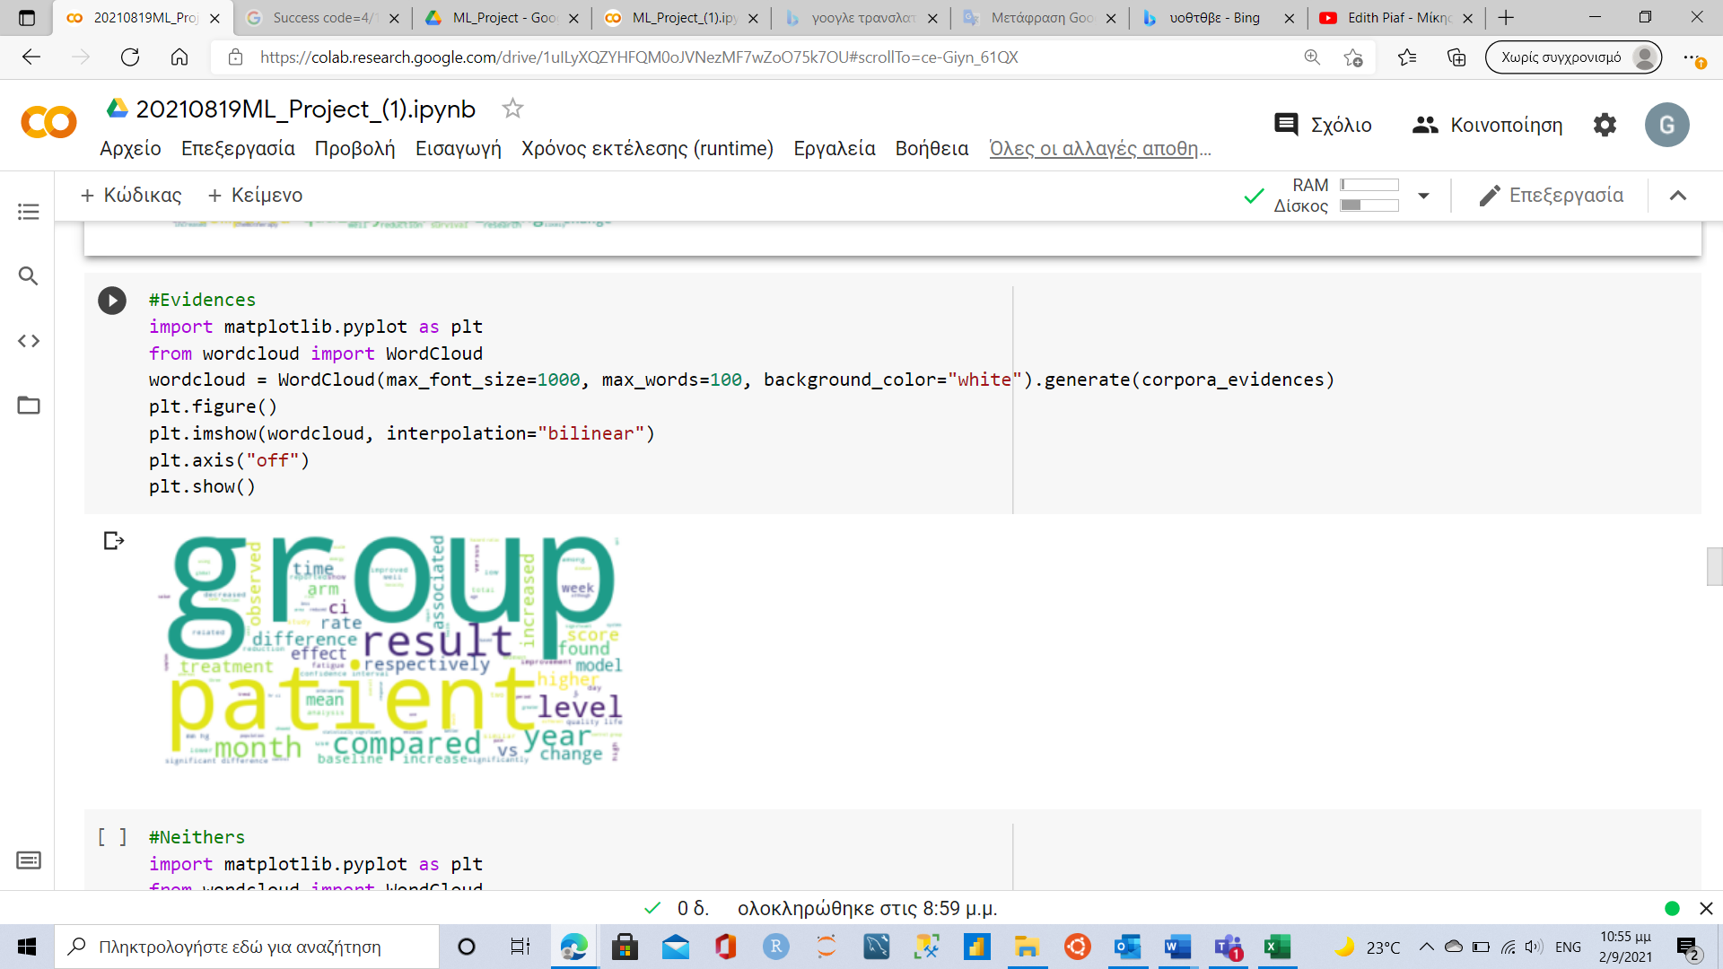
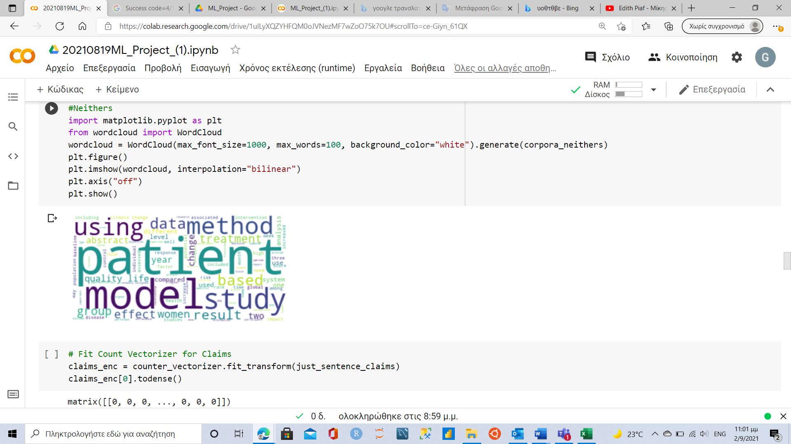
2.3 Data – exploratory data analysis (eda) (2/2)
Lexicons of the most common words for each label
CLAIMS Lexicon
EVIDENCE Lexicon
NEITHER Lexicon
Assign 3 new variables
They count the number of the top-100 words from lexicons of each label that appear in each sentence of the data-frame.
These variables will be “claims_lexicon_counts”, “evidences_lexicon_counts” and “neithers_lexicon_counts”.

Slide 8

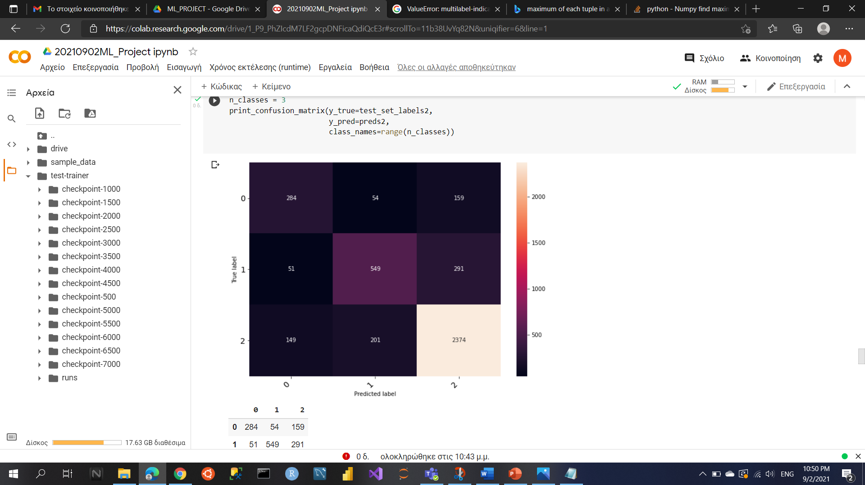
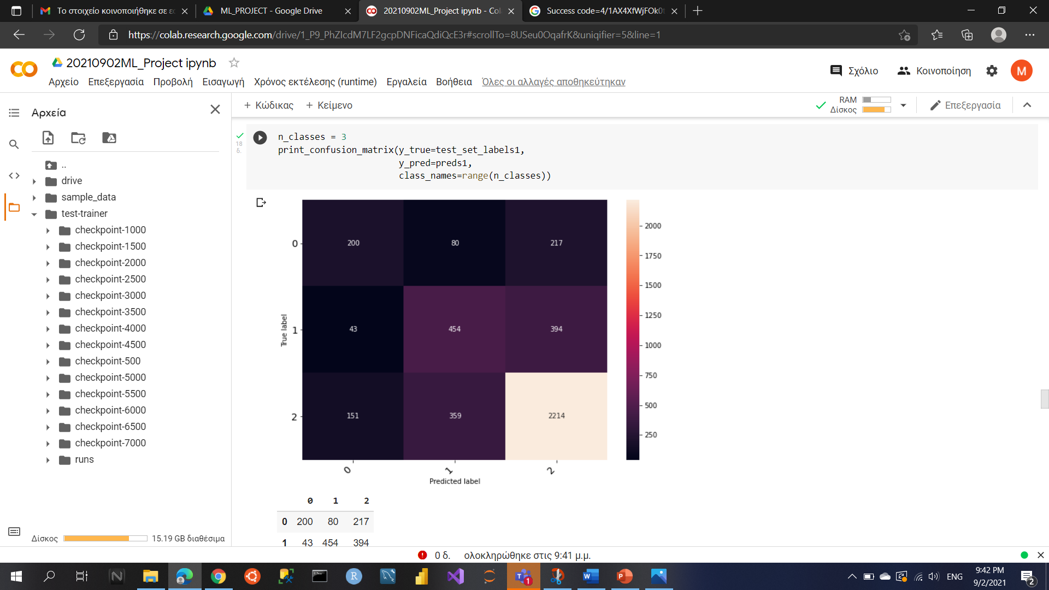
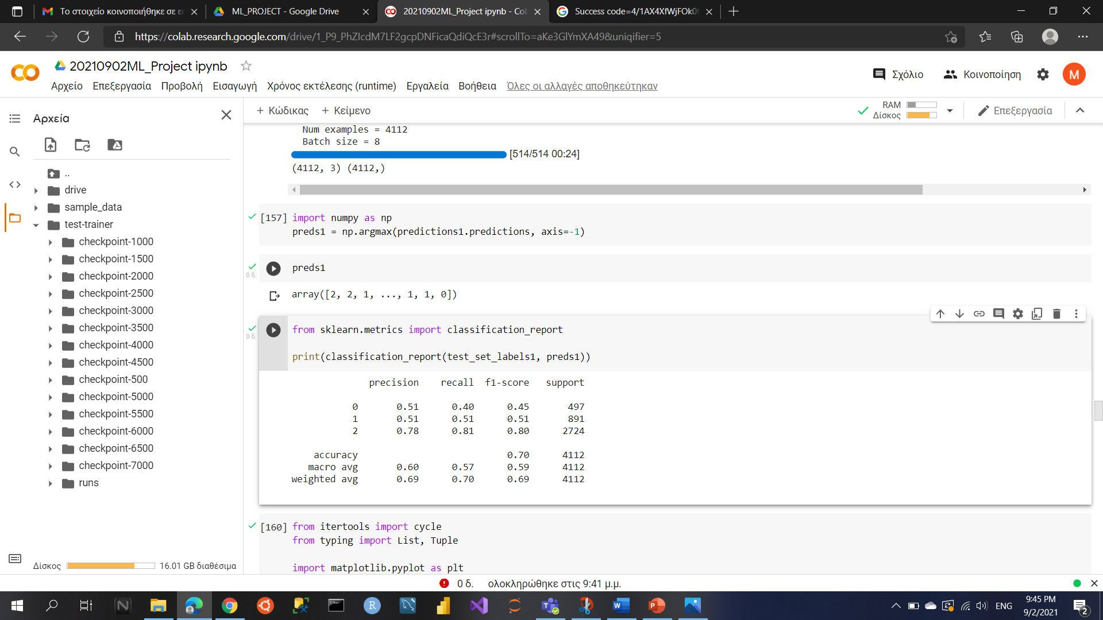
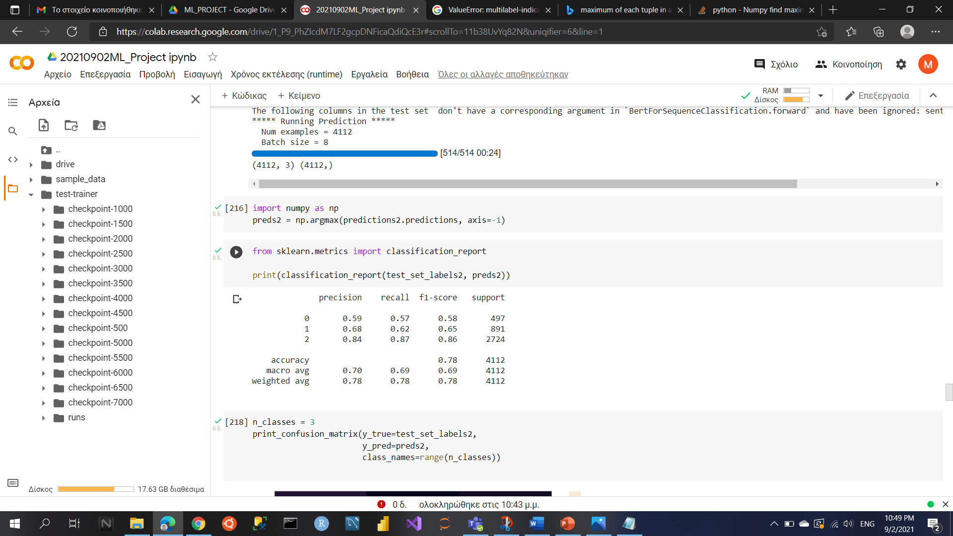
3.1 methodology / experimentation – classification models
Baseline Intuitive Model
Argument Model
Transformer Network Approach
Sentence Pair Classification Task
Title – Sentence - Label
BERT Pre-Trained Model Used
3 Epochs
1. Last sentence and that sentence is between [5th, 16th] interval, then the output label of the rule is CLAIM.
2. If the number of words in claim lexicon is greater than 1 and greater than the number of evidence and neithers lexicons respectively, and it is the pre last or second before the last sentence, then the outcome of the rule is CLAIM.
3. If the number of words in evidence lexicon is greater than 3 and greater than both the number of words in neither and claim lexicons, then the classification output is EVIDENCE.
4. All the other cases are considered as NEITHER
The lowest training loss = 0.2386 in step 6000
0 for Claim
1 for Evidence
2 for Neither
The lowest training loss = 0.239 in step 7000

Slide 9

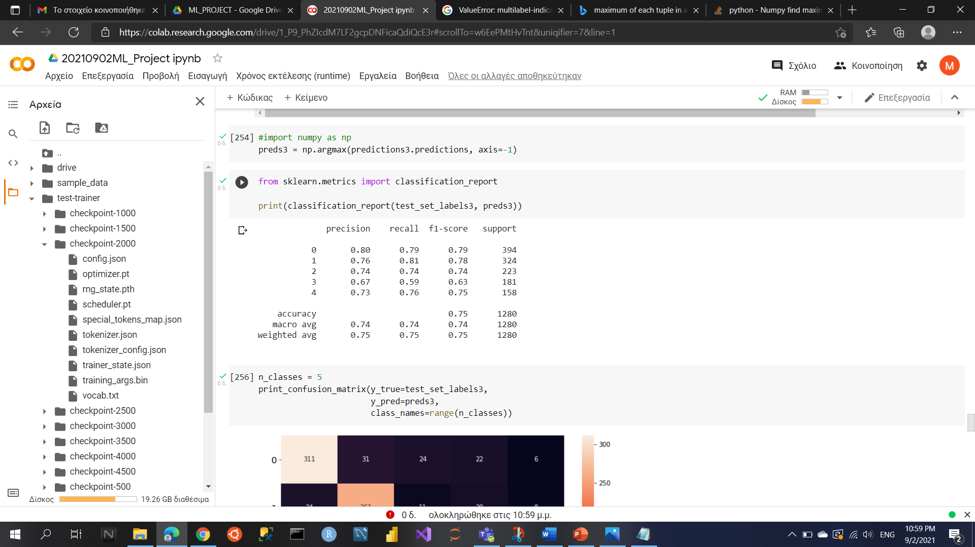
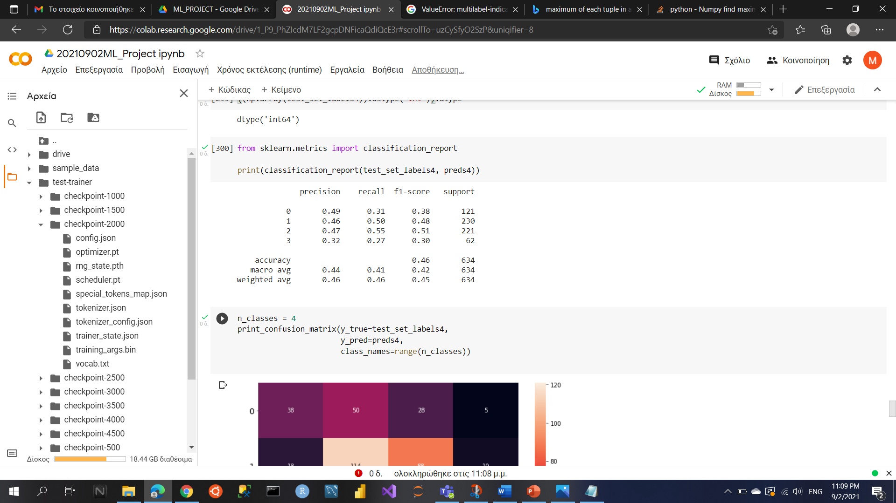
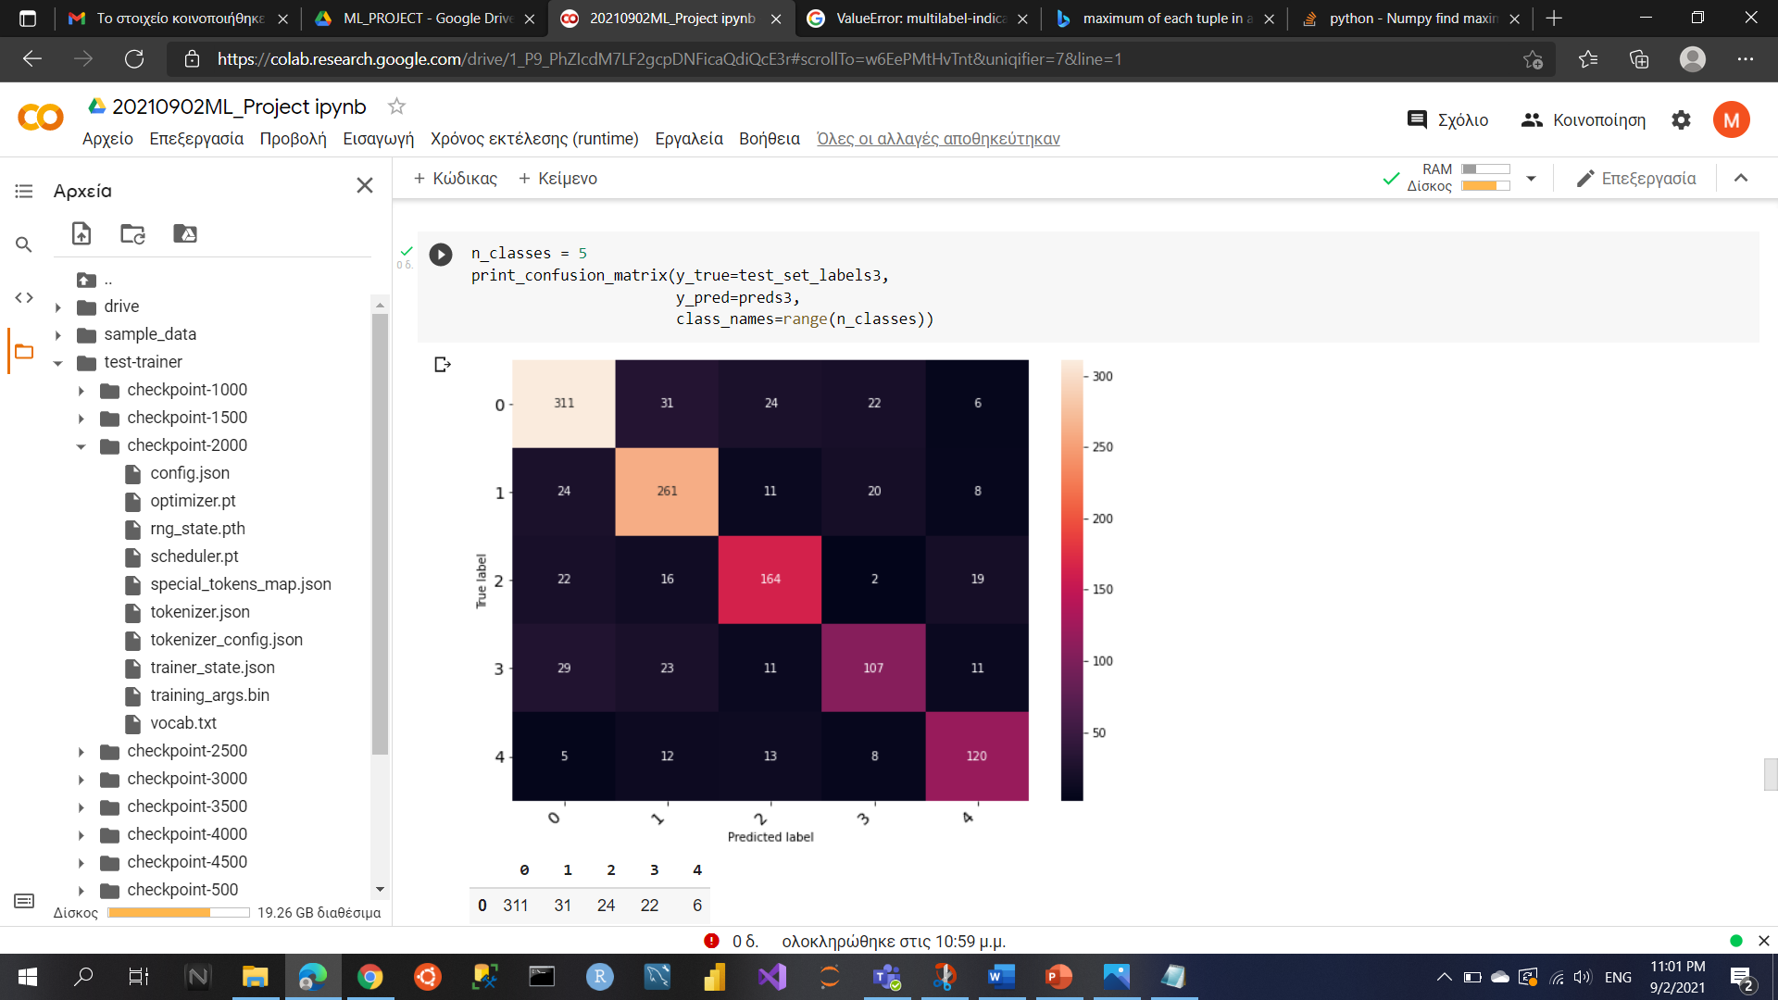
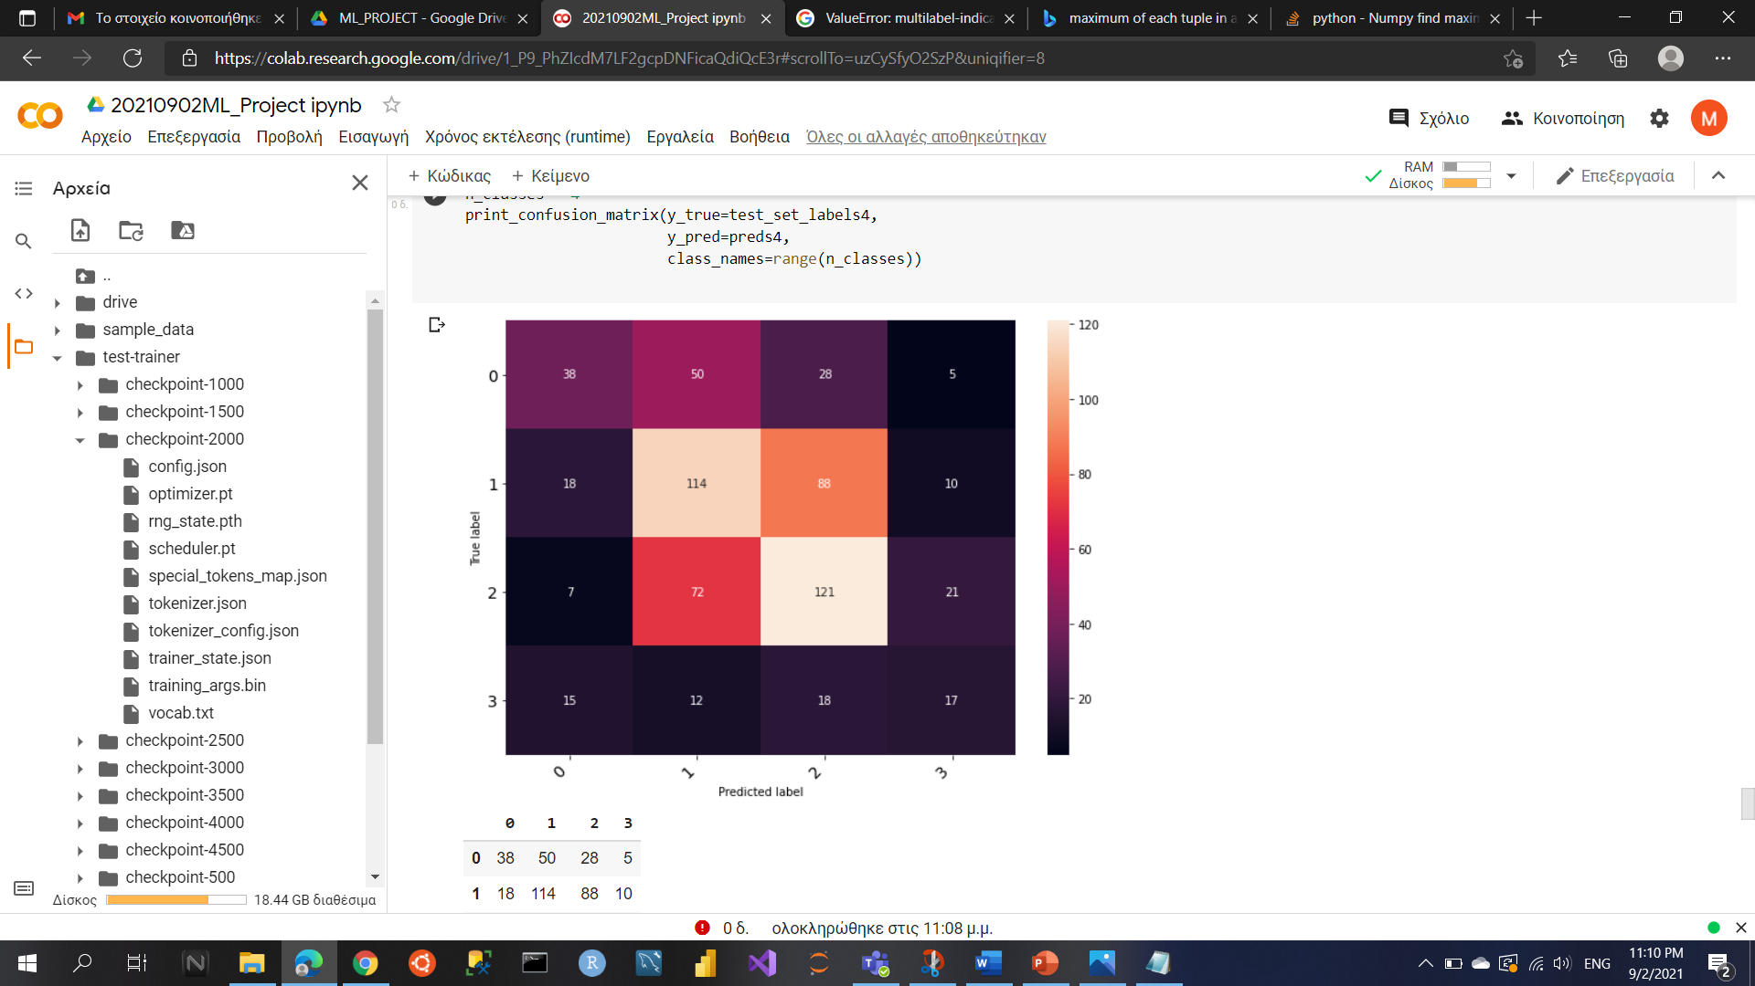
3.1 methodology / experimentation – classification models
Structure Labeling Prediction Model
Transformer Network Approach
Sentence Pair Classification Task
BERT Pre-Trained Model Used
3 Epochs
Citance Labeling Prediction Model
Title – Sentence – Label
Clain – Sentence – Label
The lowest training loss = 0.3304 in step 2000
The lowest training loss = 0.491 in step 1000
0 for Result
1 for Background
2 for Method
3 for Conclusion
4 for Objective
0 for Neutral
1 for Irrelevant
2 for Positive
3 for Negative

Slide 10

3.2 methodology / experimentation – clustering models
Data Preparation
Document embeddings for the
Abstract;
Project objective (each abstract belongs to a project)
EU Call (each project belongs to an EU call).
Sentence embeddings for the argument.
Claim only.
Claim and Evidence.
Glove Embeddings with dimension equal to 300 were used for embeddings creation of each model.
All possible combinations of those embeddings were tested for clustering.
Abstract
Abstract – EU Call
Abstract – Project Objective
Abstract – Project Objective – EU Call
Abstract - Project Objective – Claim
Abstract - Project Objective - Claim/Evidence
Abstract - EU Call – Claim
Abstract - EU Call - Claim/Evidence
Abstract - Project Objective - EU Call – Claim
Abstract - Project Objective - EU Call - Claim/Evidence

Slide 11
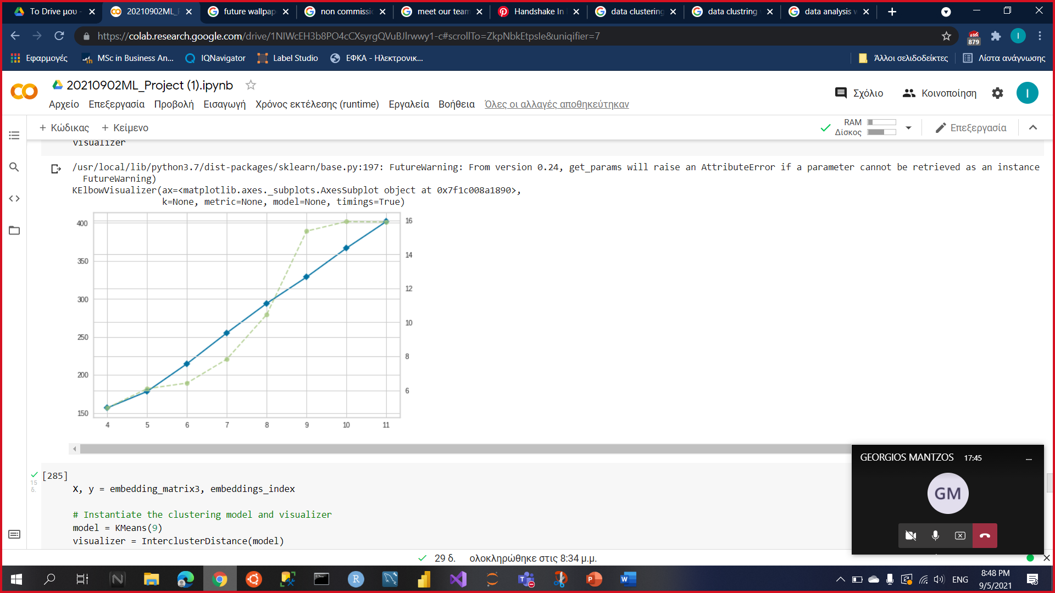
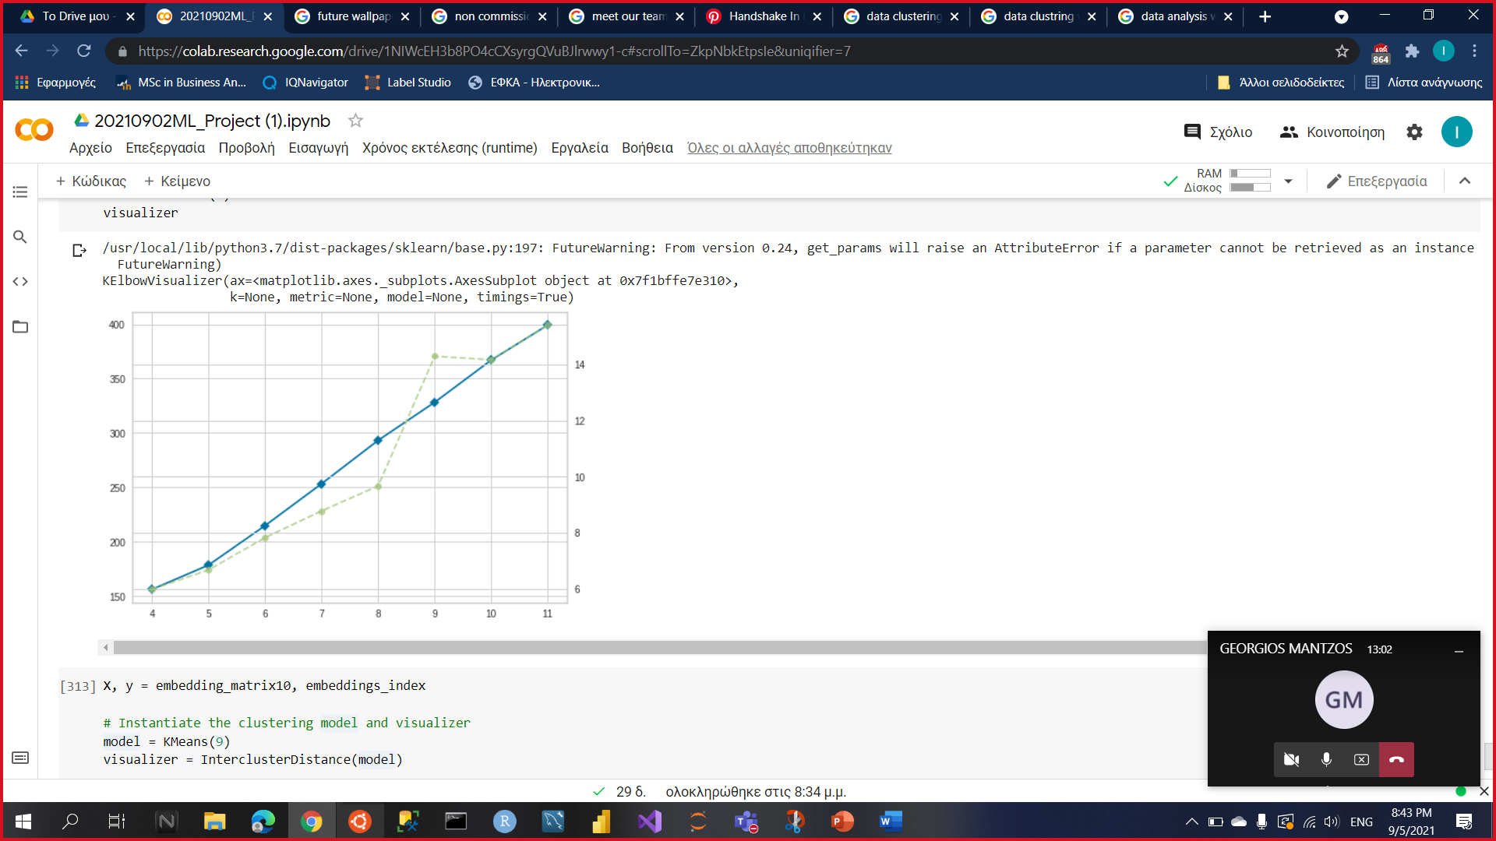
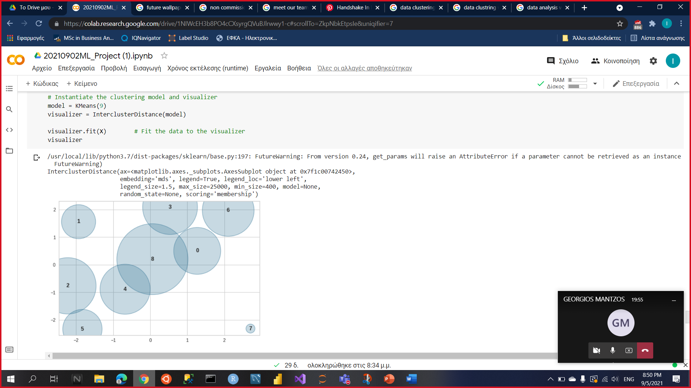
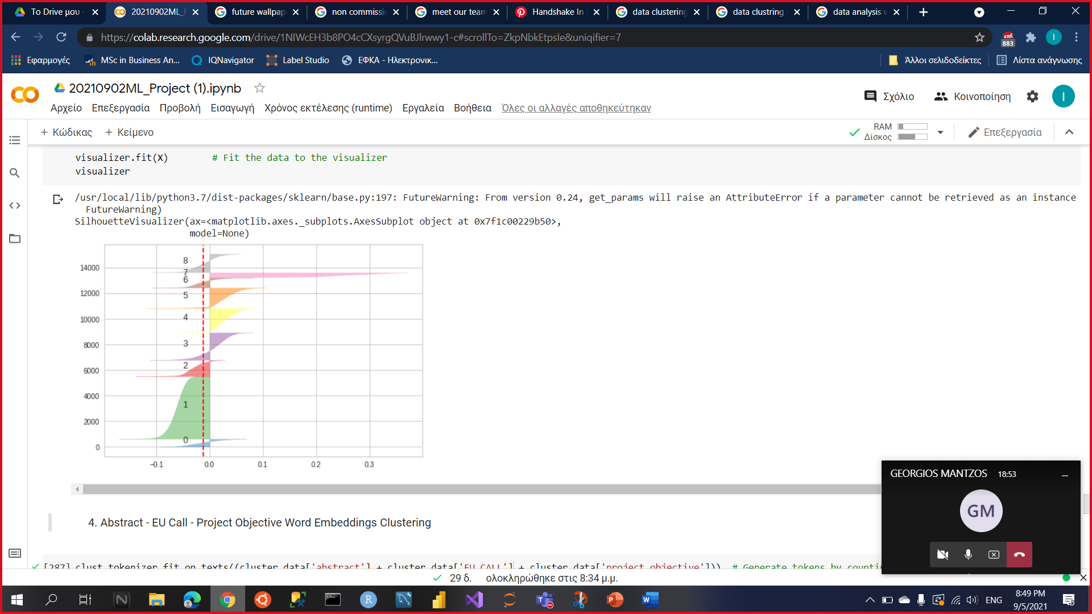
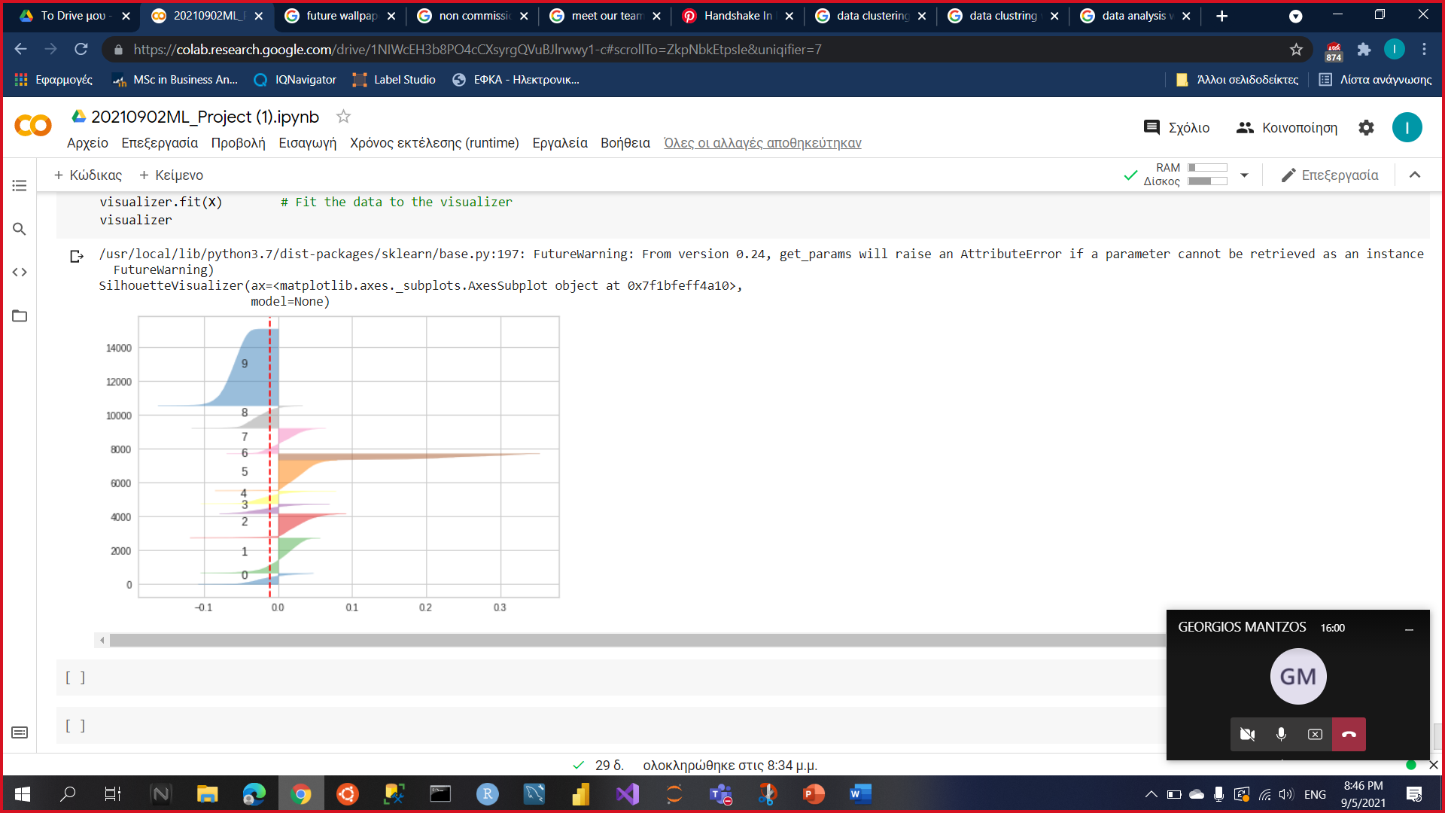
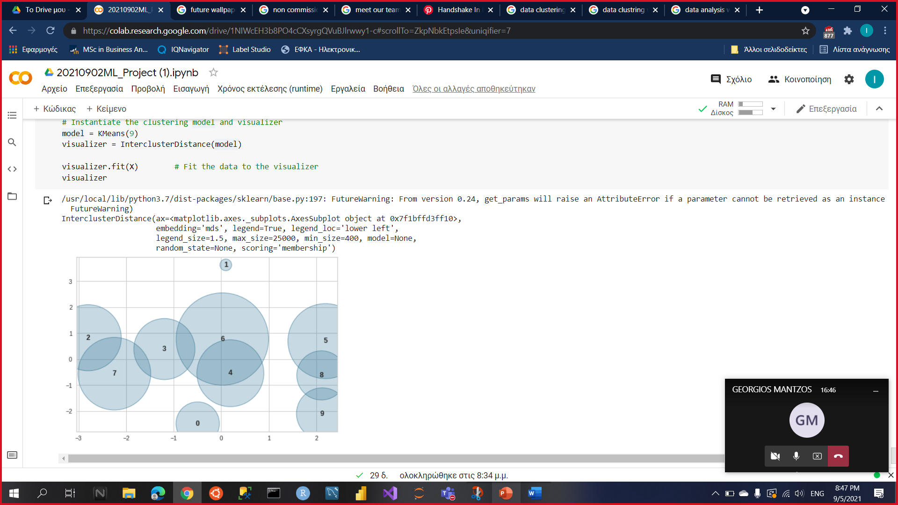
3.2 methodology / experimentation – clustering models
Best Models
Abstract - EU Call
Abstract - Project Objective - EU Call - Claim/Evidence
Further research could have as objective the improvement in both the implementation of the clustering models and the creation of embeddings for them.
In both models, the best fit is for number of clusters equal to 9. Below there are the Silhouette plots and plots to see an image o the clusters.

Slide 12



5. Meet our team
Ioannis Dimitriou
Data Engineering Consultant in Application Development,
Accenture Greece
BSc in Business Administration,
University of Macedonia
Military Administration, Hellenic Air-Force Non-Commissioned Officers School
George Mantzos​
​
Business Intelligence Analyst, ​
Grant Thornton Greece​
​
​
MSc in Applied Mathematics,​
National Technical University of Athens

Slide 13

Description of the Project
Data
Overview
Extract – Transform – Load (ETLs)
Exploratory Data Analysis (EDA)
Methodology – Experimentation
Classification Models
Clustering Models
Meet our Team

Slide 14

Questions
Questions
Questions

